Slide 1

INTRODUCTION TO MICROCONTROLLERS

Slide 2
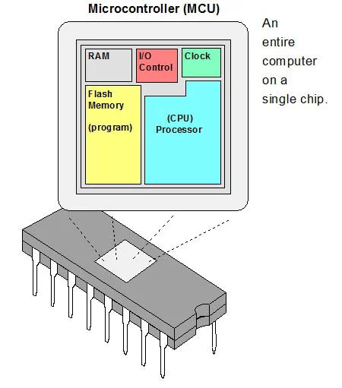
Definition of a microcontroller
Small, self-contained computer on a single chip
Helps to change the function without changing the electronic circuit
Contains CPU, memory (RAM, Flash), and I/O peripherals
Designed to perform specific tasks in embedded systems

Slide 3
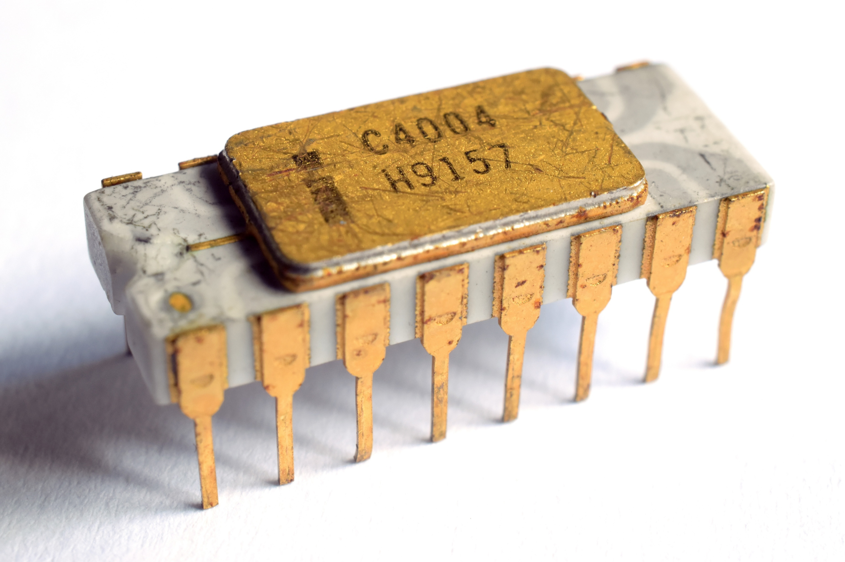
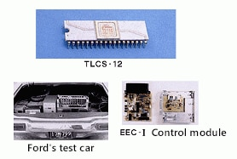
Historical background
1971: 4-bits microcontroller – Intel 4004 used in calculators by a Japanese company named BUSICOM
1973: 12-bits microcontroller – Toshiba TLCS-12 used in Ford’s cars as engine controller
1980s–90s: Rise of 8051, PIC, and AVR families
2000s–Present: Dominance of ARM Cortex-M, IoT expansion

Slide 4
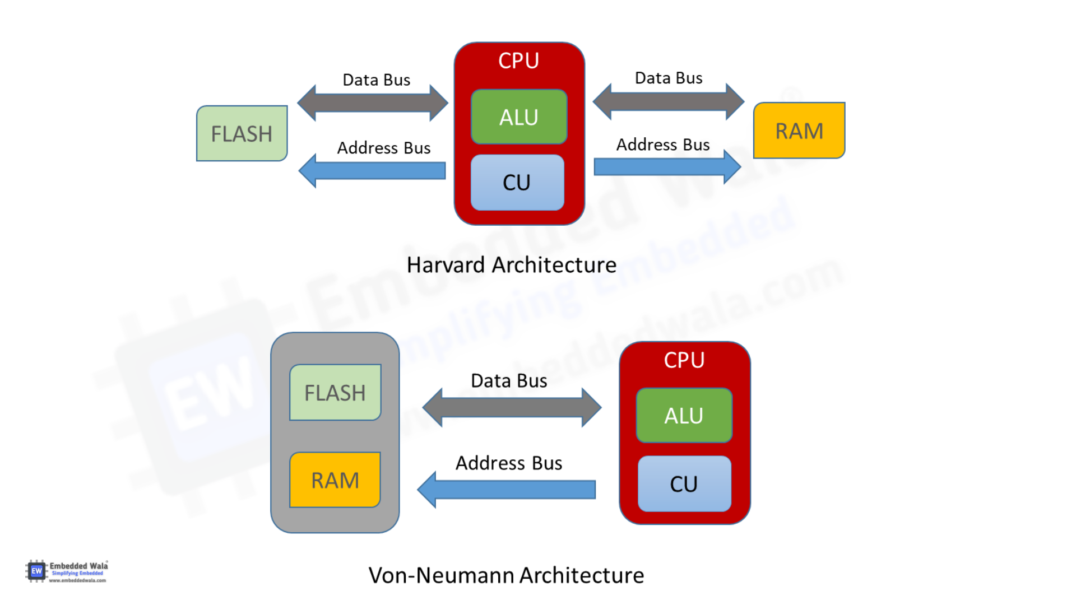
Architecture overview
Harvard architecture
Von Neumann architecture
Known as RISC (Reduced Instruction Set Computer)
Known as CISC (Complex Instruction Set Computer)
Newer than Von Neumann
Shared bus, which can cause the von Neumann bottleneck (a limitation in data throughput)
Memory bus and Data bus are separate which allows simultaneous access to data and instructions (Faster)
Simpler design

Slide 5
Architecture overview
RISC architecture
CISC architecture
Contains a hardwired programming unit
Microcoded (implemented via small programs inside the CPU)
Simple instructions decoding
Less usage of memory
A single clock cycle for instruction execution
Less number of instructions
Fixed size for instructions (32bits-4bytes)
Variable size for instructions (16 to 64 bits for each instruction)
Performance is optimized, with an emphasis on software
Performance is optimized with a focus on hardware
Commonly used in ARC, Alpha, ARC, ARM, AVR, PA-RISC, and SPARC.
Commonly used in System/360, VAX, AMD, and Intel x86 processors.

Slide 6
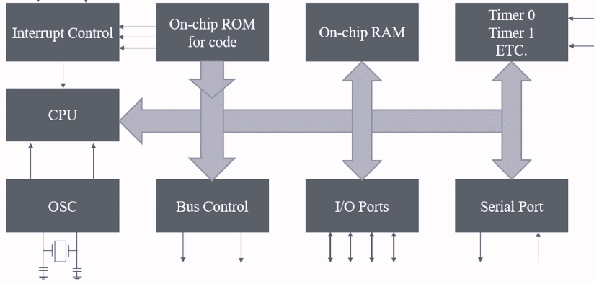
Architecture overview

Slide 7
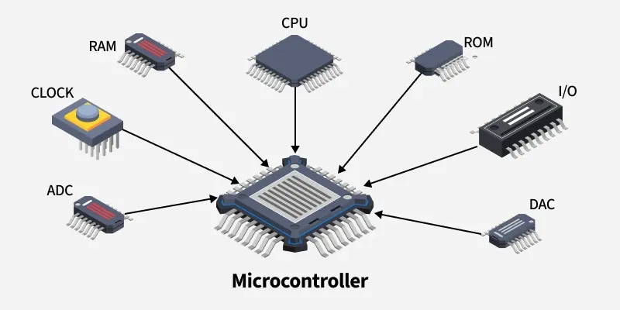
Some features and capabilities
Digital & Analog I/O
Timers, PWM, watchdogs
Communication: UART, I2C, SPI, CAN
Built-in ADC, DAC
Low-power and sleep modes

Slide 8
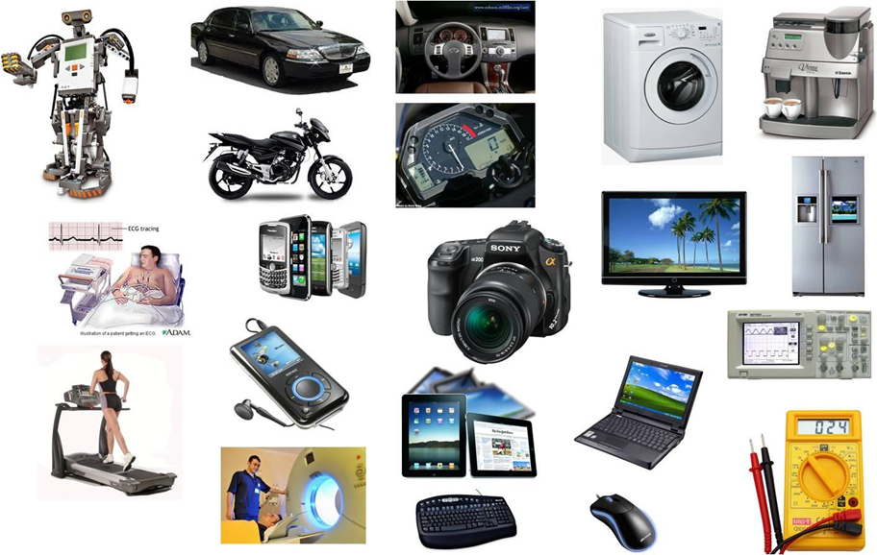
Applications of microcontrollers
Home appliances
Automotive
Medical devices
IoT and smart devices
Robotics and automation

Slide 9
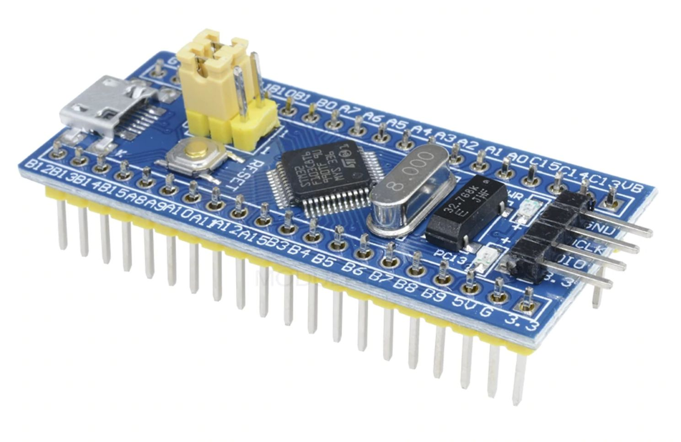
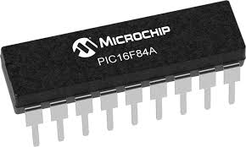
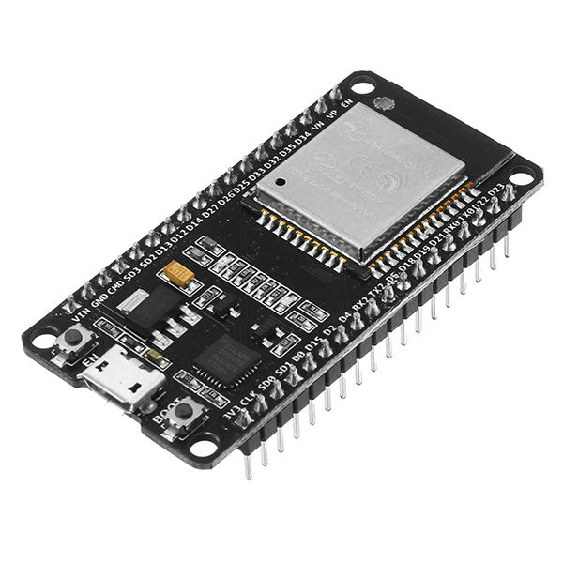
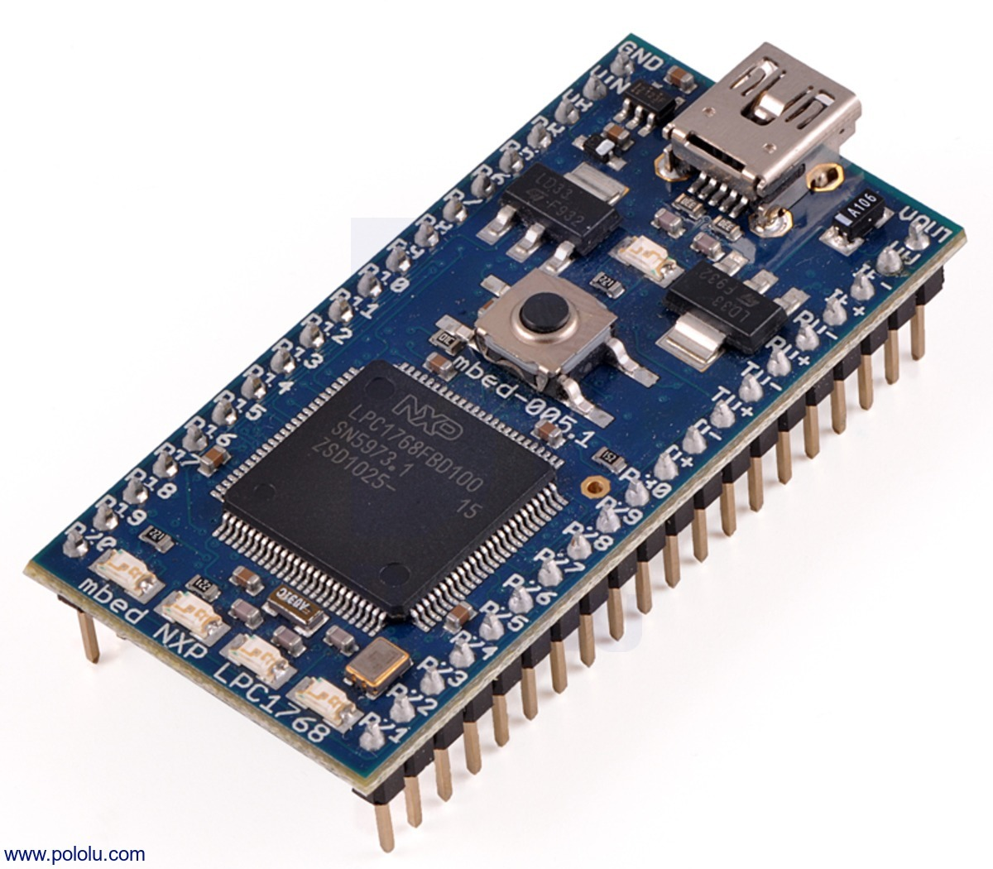
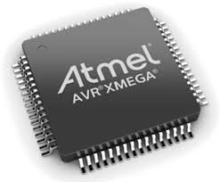
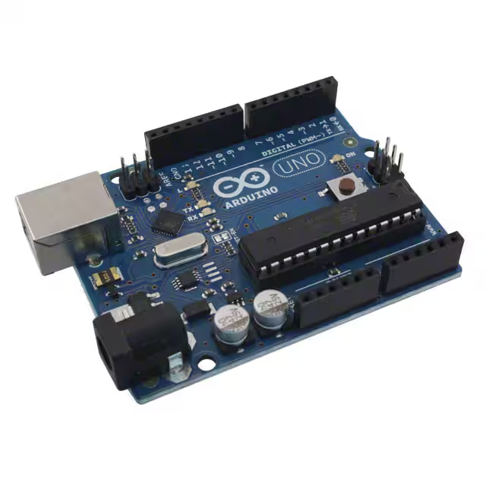
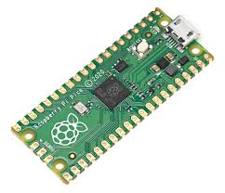
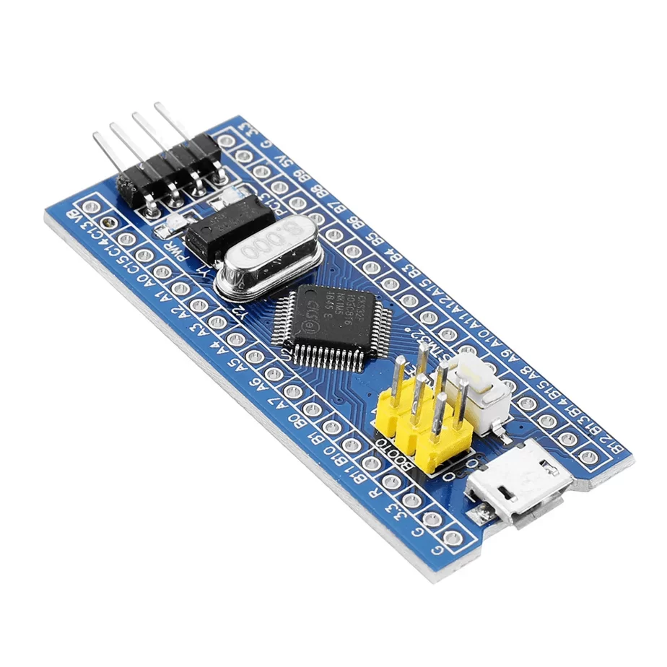
Popular microcontroller platforms
Arduino: Easy for beginners, based on AVR/ARM
ESP32/ESP8266: Wi-Fi/Bluetooth enabled
STM32/NXP: Industrial-grade, ARM Cortex-M
Raspberry Pi Pico: Dual-core RP2040 MCU
PIC & AVR: Widely used in legacy systems

Slide 10
Challenges and considerations
Limited memory and processing power
Real-time performance requirements
Power management in portable devices
Security in connected systems

Slide 11
Selecting a microcontroller
Hardware considerations
Number of inputs/outputs (GPIO)
Types of communication protocols needed
Software considerations
CPU frequency needed and decide if an external clock is nedded
Mathematical calculations (fixed point, floating point)
Microcontroller architecture
Data size (8-bit, 16-bit or 32-bit) that a CPU can handle at a time

Slide 12
Selecting a microcontroller
Memory considerations
Flash size and RAM size
Special features considerations
Built-in peripherals (PWM, ADC…), Operating voltage …
Search for adequate microcontroller
Search for communities and sources of support
Examination of costs
Examination of scalability (for future upgrades)
Examination of development tools

